Slide 1

Batch 113
Cybersecurity Enhancement through Malicious URL Detection with ML
Under the guidance of
Mr. Ch. Sandeep
Associate Professor
Presented for
Major Project Final Review
Date: 19-03-2025
Candidate No. & Name
HTNO. | Name
2103A51067 2103A51550 2103A51553 2103A51218 | Rontala Pooja Reddy Bathini Shiva Sathvika Errabelly Shruthi Challa Akshaya
Notes:
Batch 113

Slide 2
Agenda
Abstract
Introduction
Objectives
Literature Survey
Existing System
Problem identification
Proposed Methodology
System Workflow
Architecture of the proposed system
User Case Diagram
Sequence Diagram
Implementation
Results
Conclusion
Future Scope

Slide 3
Abstract
Cybersecurity threats are evolving, with malicious Uniform Resource (UR) attacks becoming more advanced and dangerous.Traditional security methods are not enough, as existing techniques struggle to detect new and evolving threats.
Feature engineering techniques like lexical analysis, host-based features, and behavioral metrics improve detection accuracy.
Various models, including supervised and unsupervised learning techniques, help analyze web traffic and detect threats.
Machine learning models, particularly deep learning and ensemble approaches, outperform traditional security methods.

Slide 4
Introduction
Malicious URLs are modified or hacked links used for cyber attacks.
They can steal data, spread viruses, or trick users into revealing sensitive information.
Machine learning helps detect these URLs by analyzing patterns like strange characters or fake domains.
A strong detection system blocks harmful links before they can cause damage.
This protects personal data and prevents cyber threats, making online browsing safer for everyone.

Slide 5
Objectives
The objective is to implement machine learning Techniques for malicious URL detection
To develop a Machine Learning model that can automatically identify and classify URLs as either safe or malicious based on their characteristics.
To enhance cyber security measures by proactively identifying potential threats, thus reducing the risk of falling victim to online threats.
To reduce dependency on traditional blacklist-based detection by implementing intelligent and adaptive models.
To minimize false positives and false negatives in malicious URL identification

Slide 6
Literature Survey
NAME​ | AUTHORS​ | YEAR​ | TECHNIQUES USED | LIMITATIONS​
Malicious URL Detection Using Machine Learning ‘MASK’ | M.Murarka K.Deshmukh | 2024 | Support Vector Machines (SVM) and Random Forests | high false-positive rates and difficulties in detecting newly emerging threats.
Machine Learning for Cybersecurity:Detecting and Preventing Cyber Attacks | A.Marengo A.Pagano | 2024 | Support Vector Machines(SVM),Decision Tree and Random Forest (RF) | Machine learning models require large datasets for accurate training.
Detecting Malicious URLs Using Machine Learning | Mr.K.V.V.Subbarao | 2023 | Support Vector Machine (SVM) and Random Forest (RF) | Reduced accuracy with complex phishing URLs

Slide 7
Existing System
Detecting Phishing URLs Using Machine Learning & Lexical Feature-Based Analysis
Suspicious URL filtering based on Logistic Regression with Multi-view analysis.
Malicious URL detection system using combined SVM and Logistic Regressions model.
Deep learning models such as CNNs RNNs and Transformers are used for feature extraction and classification.

Slide 8
Problem Identification
In Cybersecurity Enhancement through Malicious URL Detection with ML, several key challenges arise:
Increasing sophistication of cyber threats, including malicious Uniform Resource(UR) attacks.
Traditional security mechanisms struggle to detect evolving cyber threats effectively.
High false positive and false negative rates in conventional malicious UR
detection methods.
Difficulty in identifying phishing URLs and other cyber threats in real time.

Slide 9
Proposed Methodology
Collect a diverse dataset containing both malicious and benign URLs.
Extract relevant features.
Choose appropriate machine learning algorithms for classification such as Naive Bayes classifier, decision tree, Random Forest, KNN,etc.
Build and evaluate the predictive mode
Real-time monitoring system integrated with cloud-based security infrastructure for continuous threat detection.

Slide 10
System Workflow
1. User Input – The system receives URLs from users, security logs, or web traffic for analysis.
2. Feature Extraction – The system extracts lexical, host-based, and behavioral features from the given URLs to facilitate detection.
3. URL Pre-processing – The input URLs undergo preprocessing using Natural Language Processing (NLP) and parsing techniques to remove unnecessary characters, normalize text, and extract key components.

Slide 11
System Workflow
4. Real-time Threat Response- If a URL is detected as malicious, the system triggers security alerts, blocks access, or updates cybersecurity databases.
5. Anomaly Detection- Unsupervised learning methods identify unknown or evolving threats based on abnormal URL patterns.
6. Continuous Learning &Updating- The model is continuously updated with new threat intelligence data to improve detection accuracy and adapt to evolving cyber threats.

Slide 12
Architecture of Proposed System
Dataset
Collection
Pre-processing
and Feature Engineering
Exploratory Data Analysis (EDA)
Model Selection
and
Training
Model Evaluation
and
comparison

Slide 13
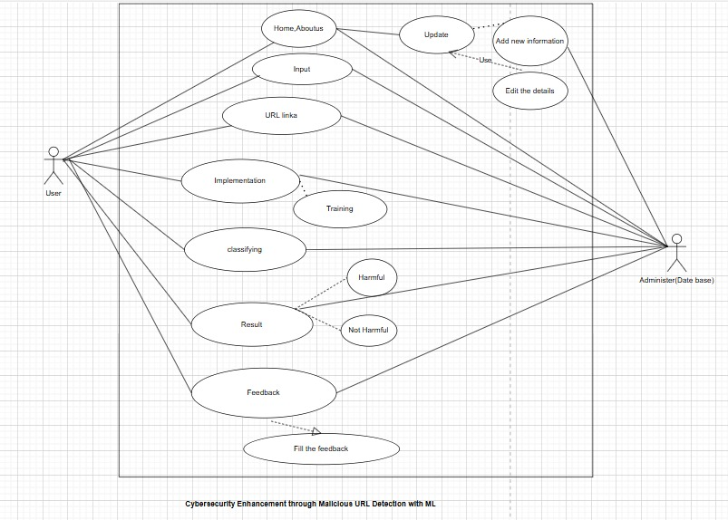
User Case Diagram

Slide 14
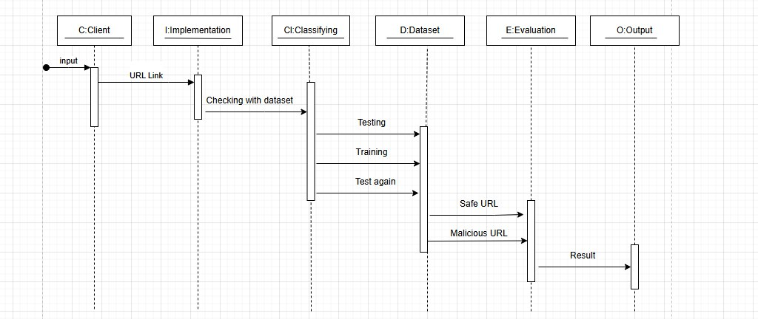
Sequence Diagram

Slide 15
Implementation
1. Flask: Python web framework for the backend (light)
2. HTML/CSS/JavaScript: The frontend interface
3. Natural Language Processing: To process user inputs
4. Algorithm: Random Forest Algorithm and KNN Algorithm are used to detect Malicious URL.

Slide 16
Result
1. The accuracy obtained by using various algorithms are analyzed and tabulated in the table below
2. So based on the above performance, Random Forest was selected as main model for detecting malicious URLs
Algorithm Used | Accuracy obtained
Naïve Bayes Classifier | 82.6%
Decision Tree | 95.4%
Random Forest Classifier | 96%
K Nearest Neighbor Algorithm | 95.5%

Slide 17
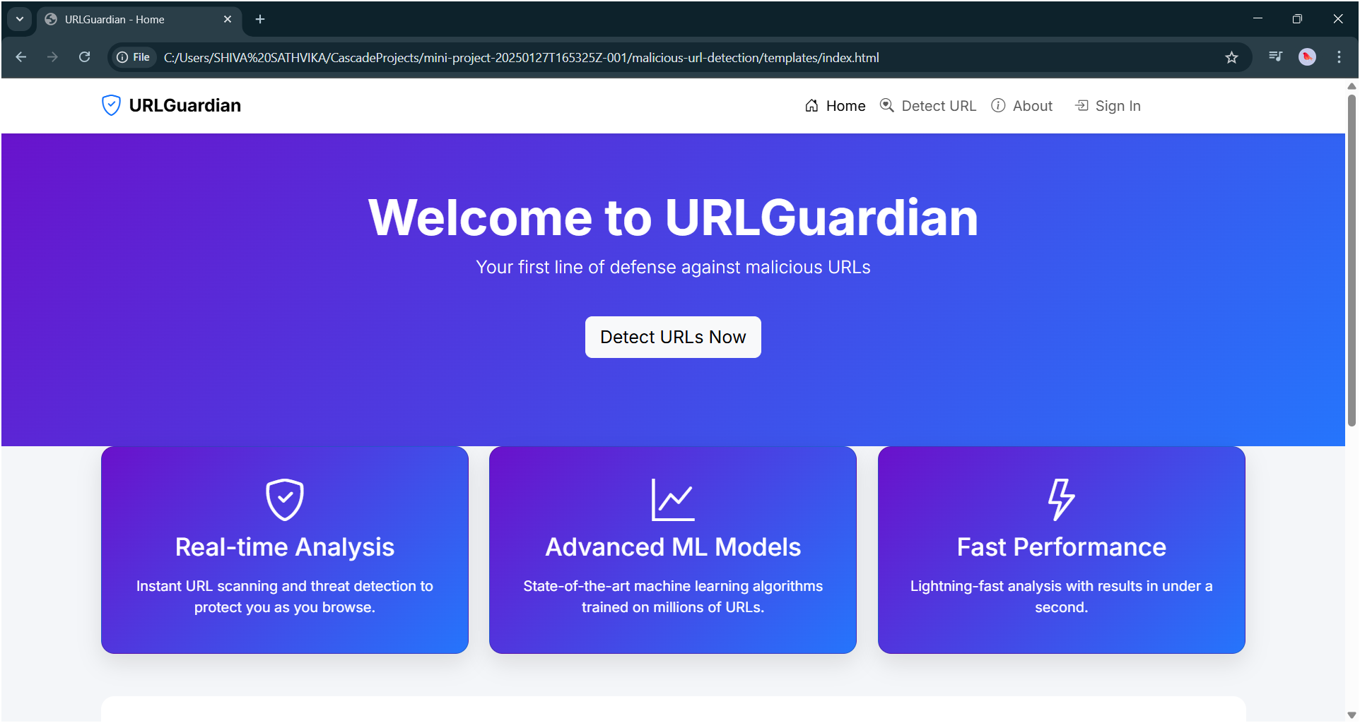
Result

Slide 18
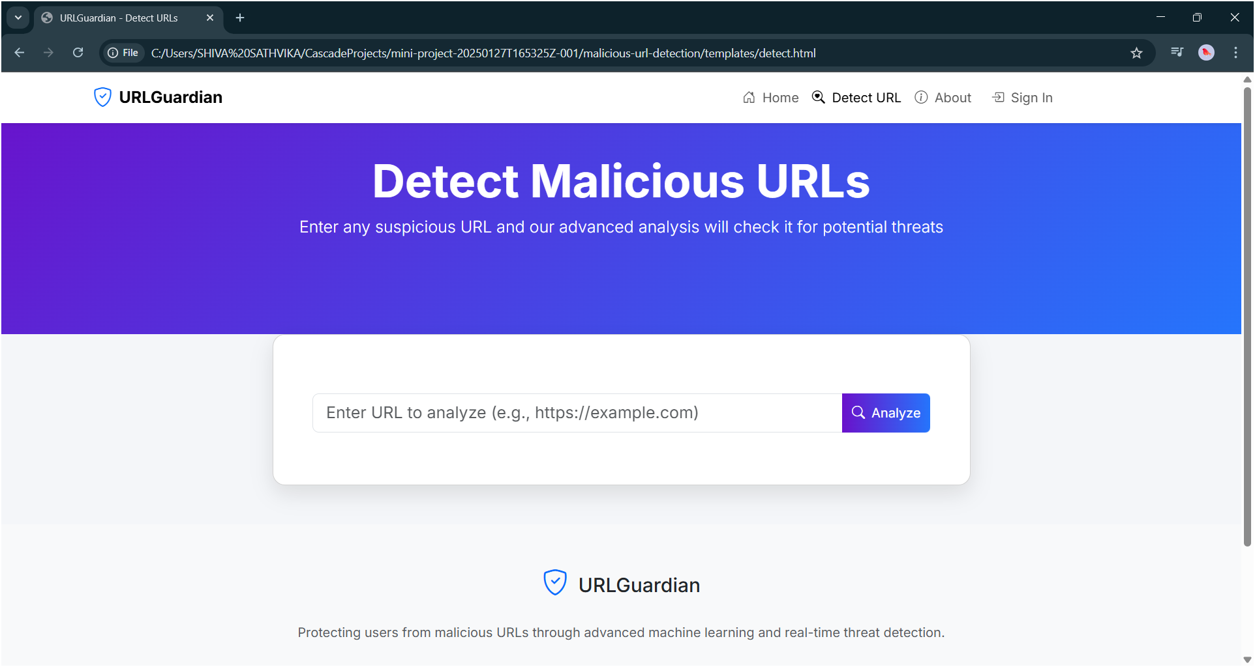
Result

Slide 19

Result

Slide 20
Conclusion
The dependence of various features of various URL were analyzed and various features were used to determine the type of a URL.
Different machine learning algorithms were applied in order to come up with a model that classifies the URL as Benign, Malware, Phishing, and Defacement URL.
Based on the accuracy score observations, Random Forest algorithms made better predictions with an accuracy of 96%.

Slide 21
Future Scope
Integration with AI-powered cybersecurity systems will enhance threat intelligence and automate responses by combining machine learning with AI-driven security frameworks.
Advanced deep learning models such as transformers and reinforcement learning will be implemented to improve accuracy and adaptability.
Detection models will be integrated directly into web browsers, antivirus software, and firewalls to enhance user protection.
Real-time detection and prevention systems will be developed to instantly block malicious URLs before they cause harm.
Automated threat intelligence sharing will be implemented by collaborating with global cybersecurity networks to improve collective defense mechanisms.

Slide 22
THANK YOU

